Slide 1



MAASTRICHT UNIVERSITY
EXPLAINABLE MULTIMODAL SIMILARITY SCORING: FINDING SIMILAR PRODUCTS IN THE FASHION INDUSTRY
By Dimitri Feizai
1

Slide 2
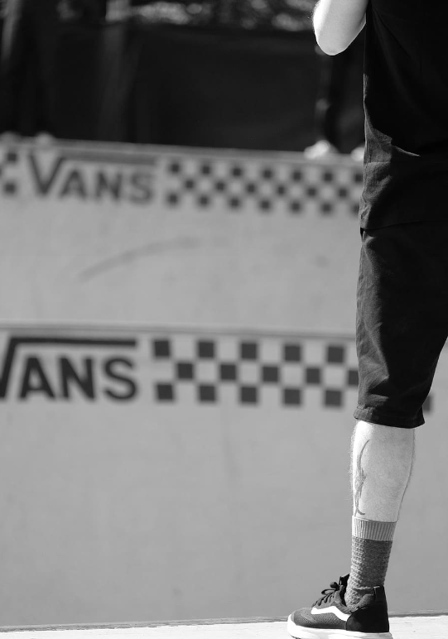





CONTENTS
Introduction
Research Questions
Related Work
Methodology
Results
Discussion
Conclusion & Future Work
2

Slide 3

MAASTRICHT UNIVERSITY
INTRODUCTION: MULTIMODAL DATA
What is Multimodality?
Different types of information
3

Slide 4
MAASTRICHT UNIVERSITY
INTRODUCTION: MULTIMODAL DATA
What is Multimodality?
Different types of information
Why Multimodal Data Matters?
Real-world information is rarely one-dimensional
Combining diverse data sources offers deeper and broader insights
4

Slide 5
MAASTRICHT UNIVERSITY
INTRODUCTION: MULTIMODAL DATA
What is Multimodality?
Different types of information
Why Multimodal Data Matters?
Real-world information is rarely one-dimensional
Combining diverse data sources offers deeper and broader insights
Multimodality in Fashion
Fashion products are inherently multimodal
Visual & Textual data
5

Slide 6

THE ROLE OF AI IN FASHION: EXPLAINABILITY CHALLENGES
Challenge in Identifying Similar Products
Lack of Ground Truth
Complexity of Multimodal Data
Limitations of Traditional Metrics
6

Slide 7





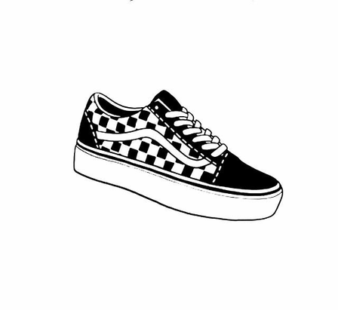








RESEARCH QUESTIONS
How can we effectively integrate multiple data modalities?
1
2
How can we explain the similarity scores between items based on multimodal information?
3
How can we evaluate the accuracy and correctness of the explanations provided by explainable AI (XAI) techniques?
7

Slide 8

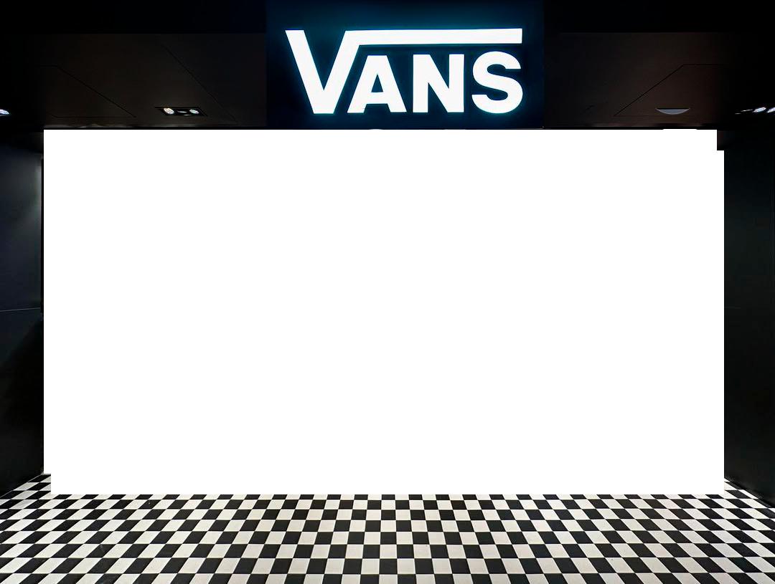
RELATED WORK
Traditional Similarity Models
Multimodal Similarity Models
Explainability
Pretrained CNNs on ImageNet
Cosine Similarity
Jaccard Similarity
Siamese Networks
Clip by OpenAI (State Of the Art)
FashionClip
Attention Based
Counter Factual ( What IFs )
Feature Based: LIME , SHAP
8

Slide 9
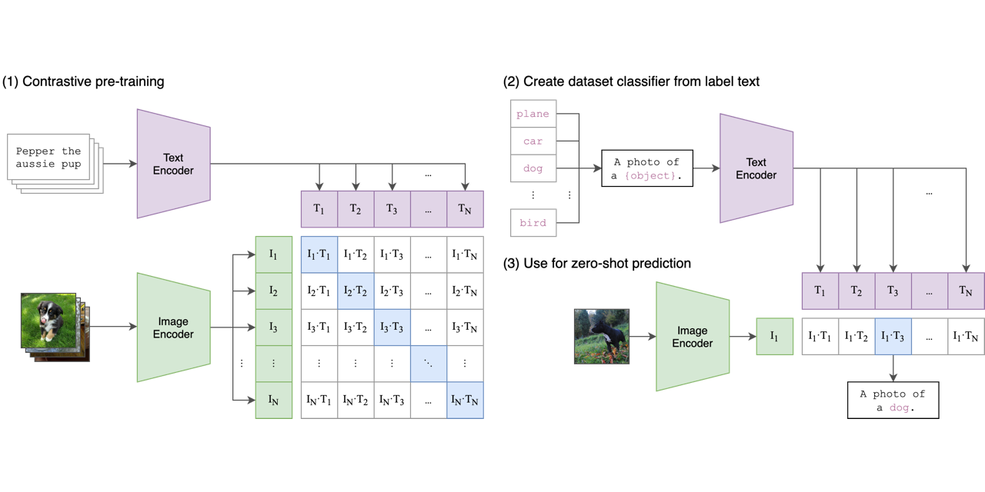
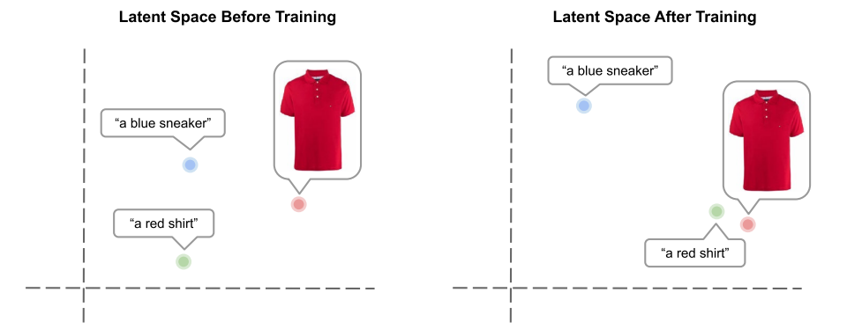
CLIP
Versatile Vision-Language
Model
Pretrained on Web Data
Zero-Shot Learning
Embedding Space Alignment

Slide 10
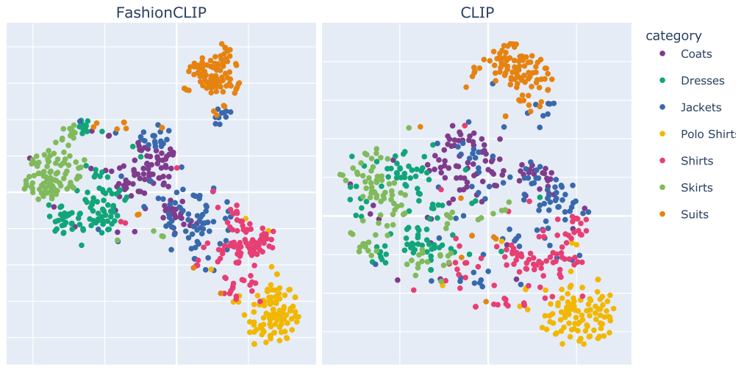
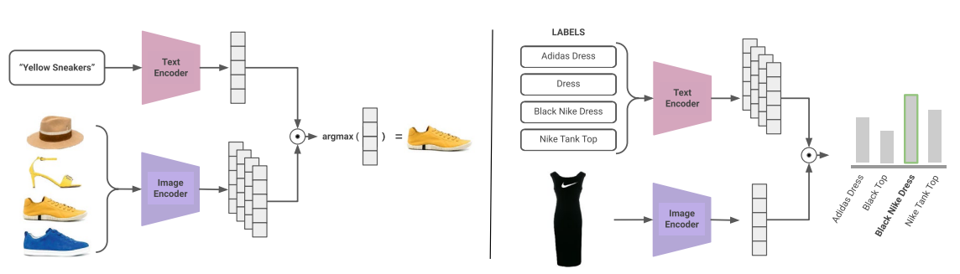
FASHIONCLIP
PCA 2 Components
FashionClip is trained on a high quality novel fashion dataset
77 token Limit
10

Slide 11
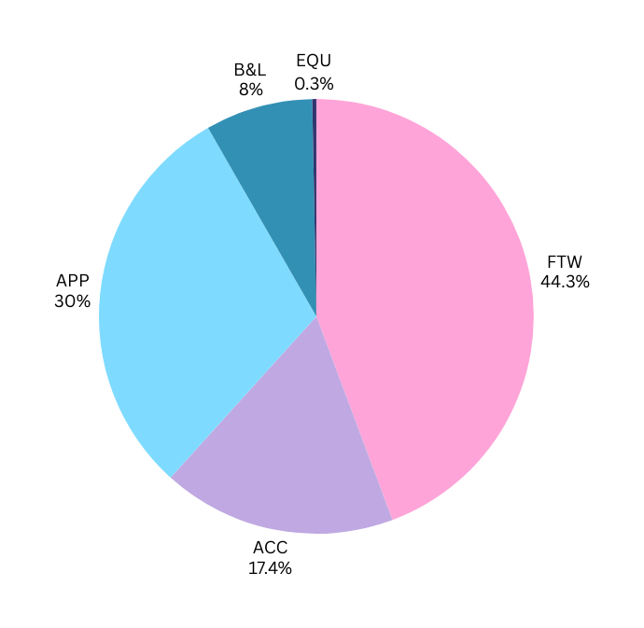
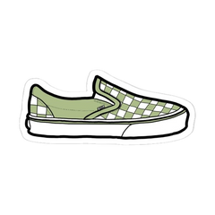
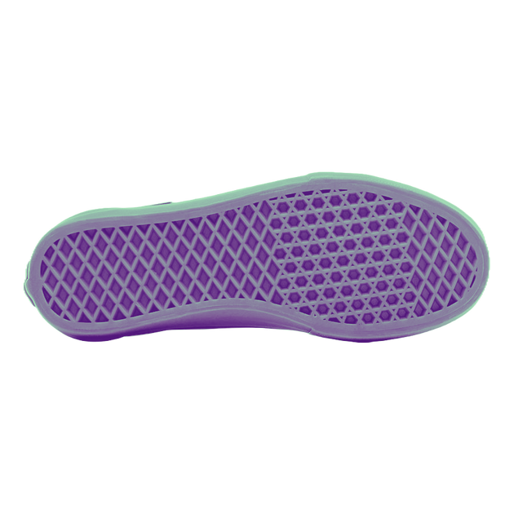
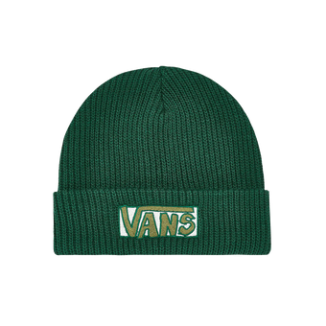
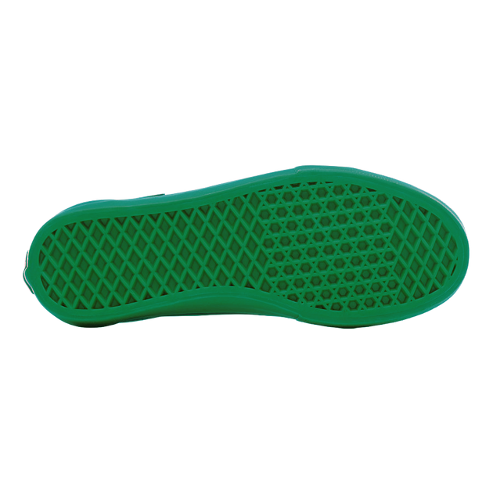
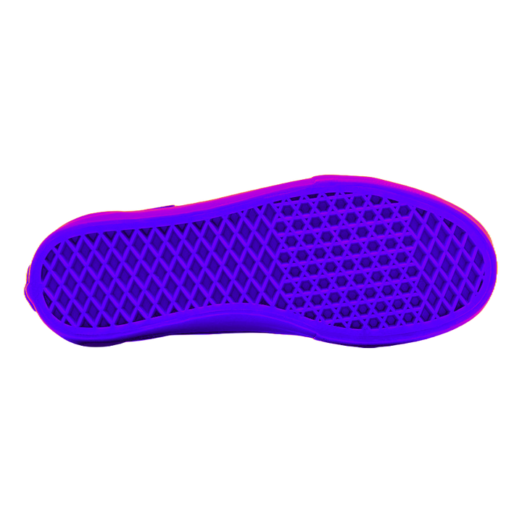
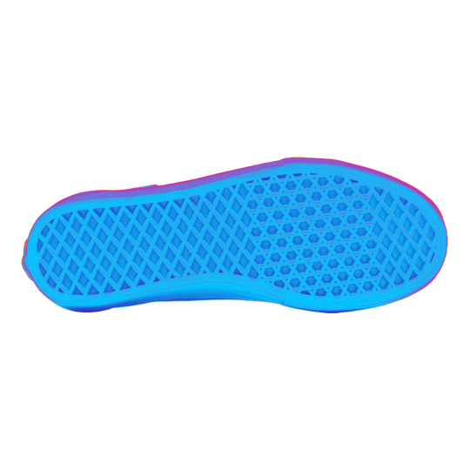
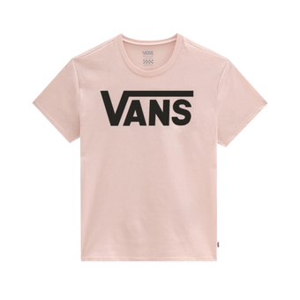
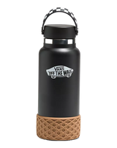
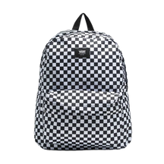
VANS DATA
TOTAL:
8033 Distinct Products
5 PRODUCT CATEGORIES
DEMOGRAPHICS
Product Descriptions
Product Compositions
Product Categories Weight (%)
FTW Sub-Categories Weight (%)
PRODUCT CATEGORIES
Footwear (FTW)
66 % Adults
Accessories (ACC)
Apparel (APP)
20% Kids
Equipment (EQU)
13 % Mens
1 % Womens
Bags & Luggage (B&L)

Slide 12




MULTIMODAL SCORE
w_img = 60%
w_text = 10%
APPROACH:
w_color = 30%
Similarity (p1,p2)
w_img ∗ img_sim(p1,p2)
w_txt ∗ txt_sim(p1, p2)
w_color ∗ color_sim(p1, p2)
12

Slide 13

MULTIMODAL SCORE: IMAGE SIMILARITY
APPROACH:
Similarity (p1,p2)
w_img ∗ img_sim(p1,p2)
w_txt ∗ txt_sim(p1, p2)
w_color ∗ color_sim(p1, p2)
13

Slide 14
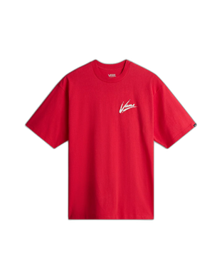
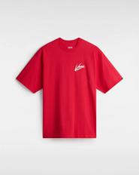
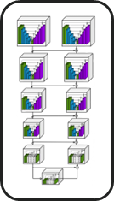


IMAGE PREPROCESSING
INPUT IMAGE
U2-NET
BACKGROUND REMOVAL
OUPUT IMAGE
14

Slide 15
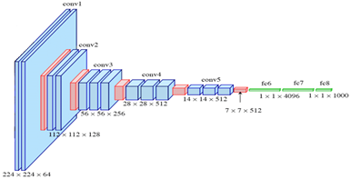
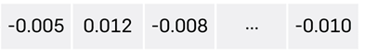
IMAGE SIMILARITY
PRETRAINED CNN
IMAGE EMBEDDING
15

Slide 16
MULTIMODAL SCORE: TEXT SIMILARITY
APPROACH:
Similarity (p1,p2)
w_img ∗ img_sim(p1,p2)
w_txt ∗ txt_sim(p1, p2)
w_color ∗ color_sim(p1, p2)
16

Slide 17
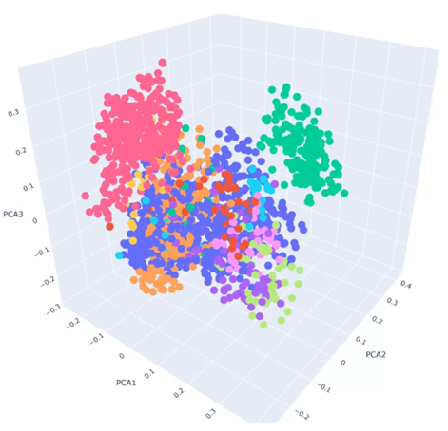
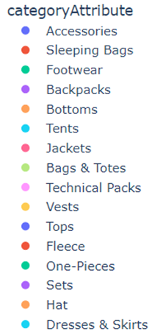
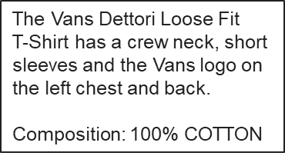


TEXT SIMILARITY
SENTENCE TRANSFORMER
17

Slide 18
MULTIMODAL SCORE: COLOR SIMILARITY
APPROACH:
Similarity (p1,p2)
w_img ∗ img_sim(p1,p2)
w_txt ∗ txt_sim(p1, p2)
w_color ∗ color_sim(p1, p2)
18

Slide 19
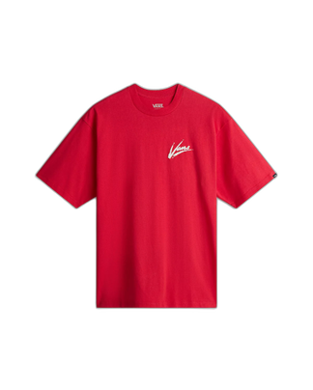
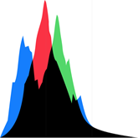
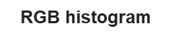
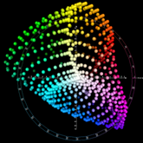
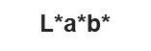


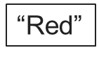
COLOR SIMILARITY
19

Slide 20
EXPLAINABLE AI
lime
grad - cam
Local Interpretable Model-agnostic Explanations
Highlights the most influential features
Gradient-weighted Class Activation Mapping
Visualizes the regions that contribute most
20

Slide 21
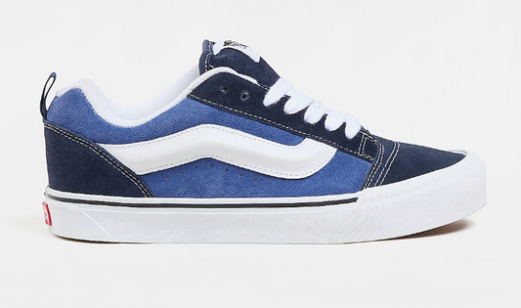
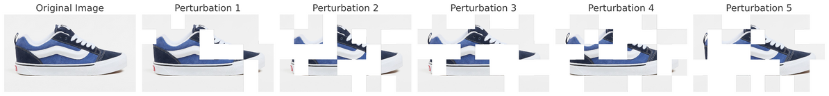
Explainability: LIME
MAASTRICHT UNIVERISITY
Perturbation of Input Features
We preprocess and perturb the input image, including resizing, normalization, and embedding calculation using a pre-trained model in this implementation. The perturbations simulate changes in the image features
Training the Surrogate Model
Generate training data using LIME perturbations
Train linear regression model on 1000 perturbed samples
Visualize segment importance with color-coded heatmap
Similarity(p1,p2) = w_img ∗ img_sim(p1,p2)
21

Slide 22
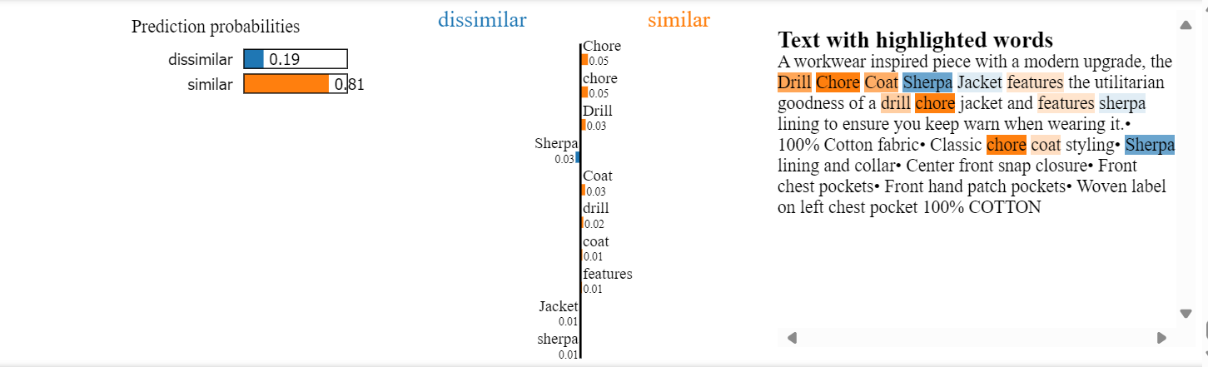
Explainability: LIME
MAASTRICHT UNIVERISITY
Perturbation of Input Features
We use LIME's built-in text perturbation method. This method generates perturbed versions of the input text by randomly removing words. These perturbations allow us to understand which words or phrases influence the similarity score the most
Training the Surrogate Model
Generate text variations using LIME's random word removal
Train sparse linear model on perturbed text samples
Calculate word-level impact on similarity scores
22

Slide 23
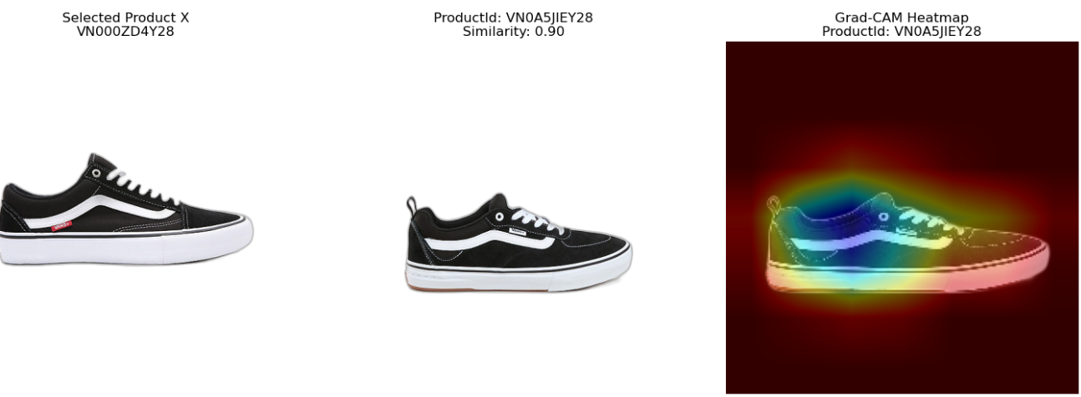
Explainability: GRAD - CAM
MAASTRICHT UNIVERISITY
Generating Visual Explanations
Gradient Calculation: Computes the importance of each feature map in the final convolutional layer
Weighted Feature Maps: The important feature maps are combined, and only the positive contributions are retained to highlight influential regions
Heatmap Overlay: The resulting heatmap is upsampled and overlaid on the original image
23

Slide 24
RESULTS
24

Slide 25
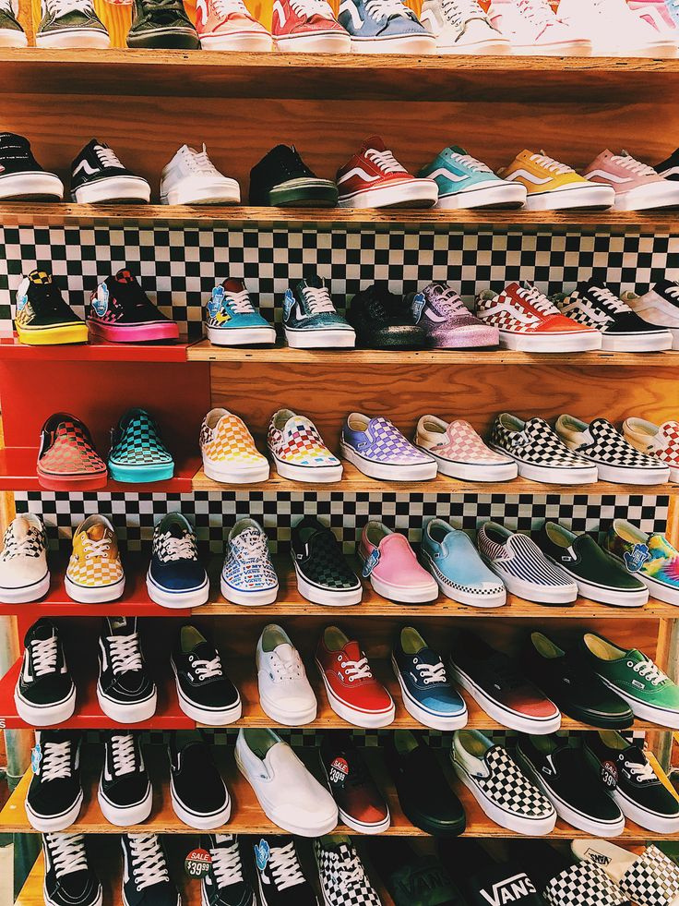
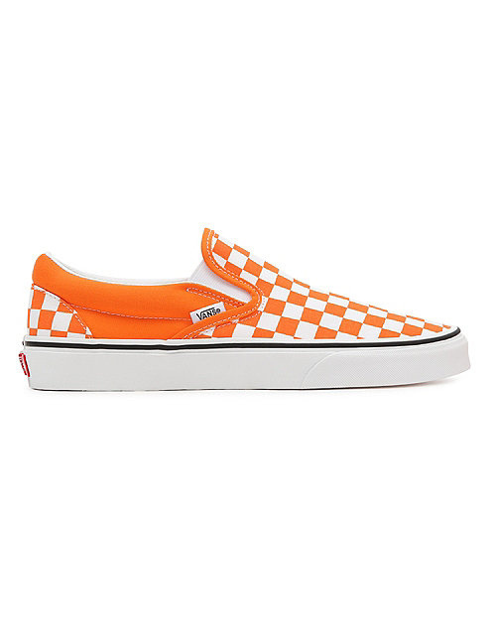

25

Slide 26
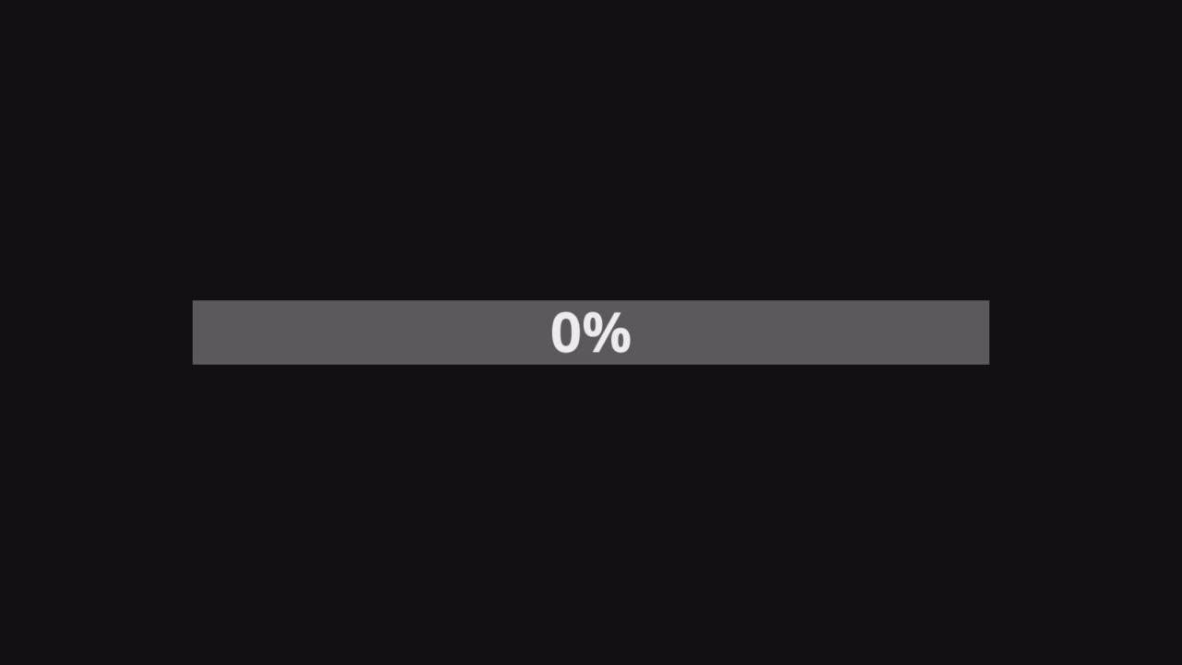
26

Slide 27
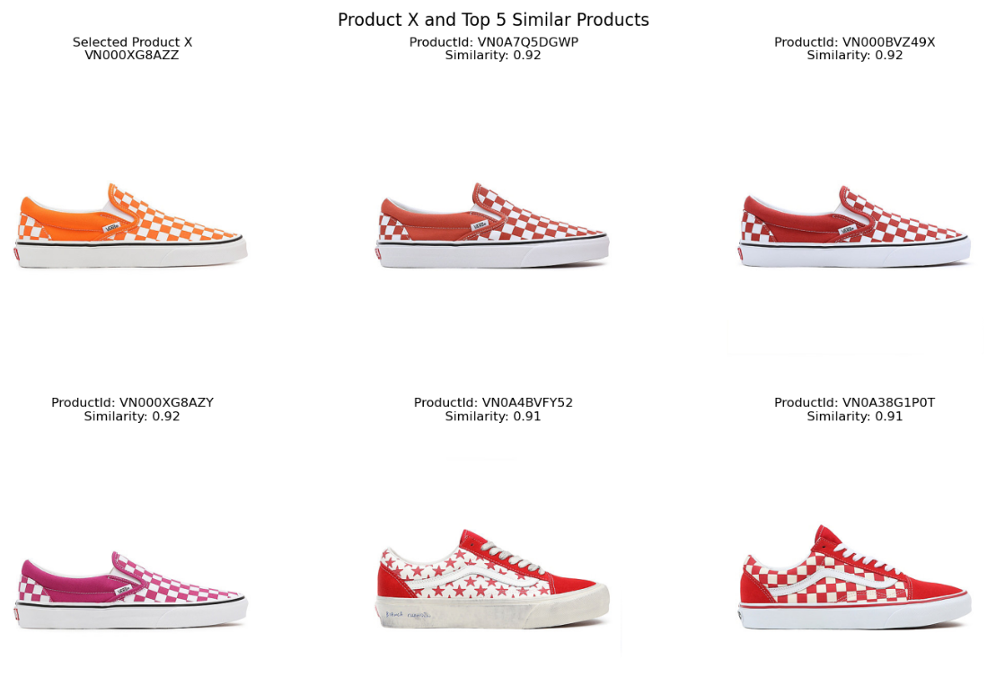
MULTI-SIMILARITY SCORING RESULTS
27

Slide 28
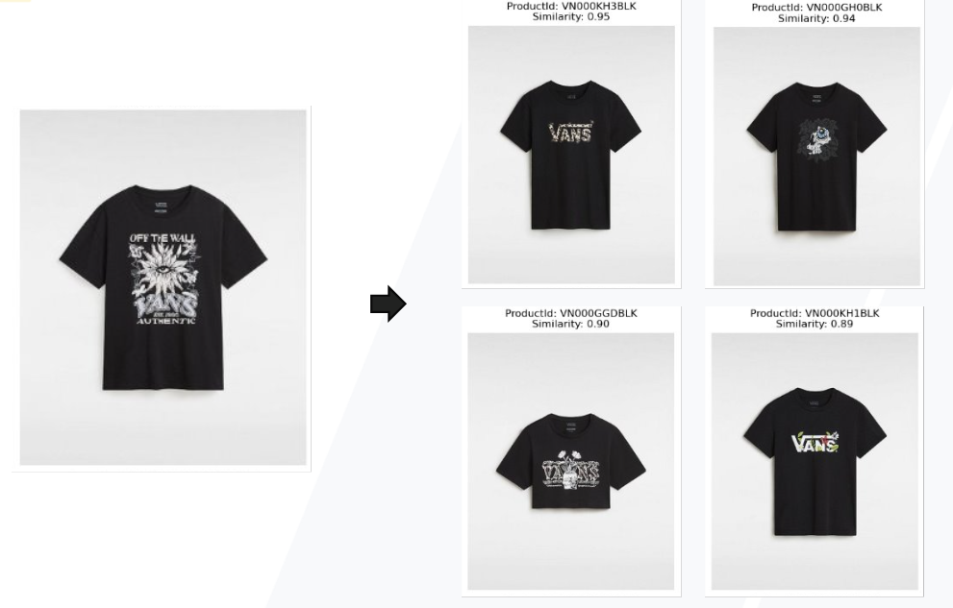
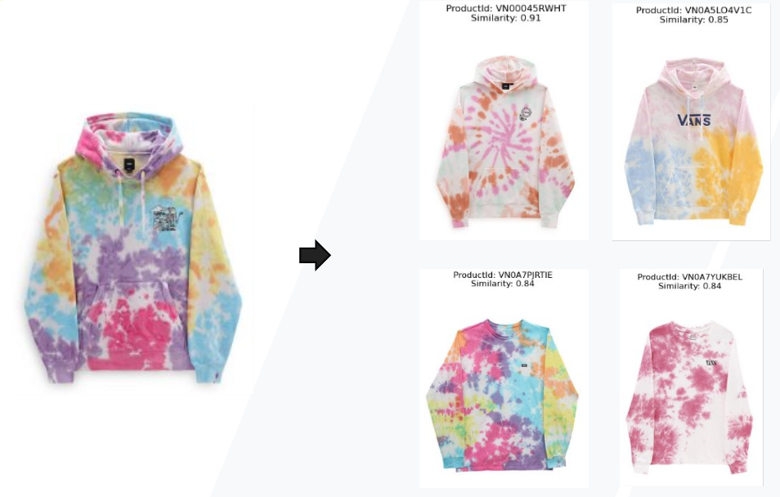
MULTI-SIMILARITY SCORING RESULTS
28

Slide 29
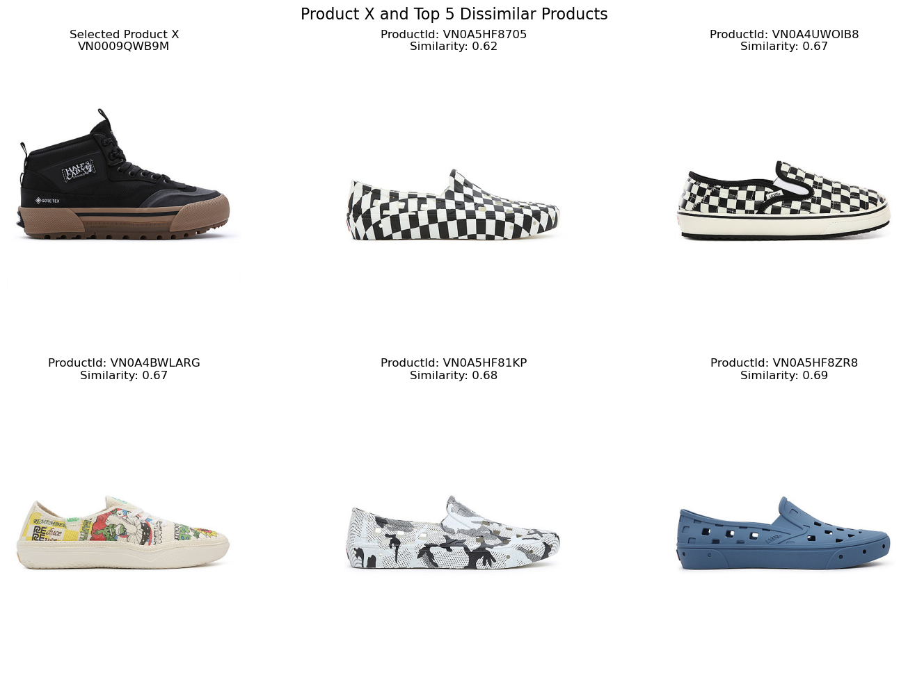
MULTI-DISSIMILARITY SCORING RESULTS
29

Slide 30
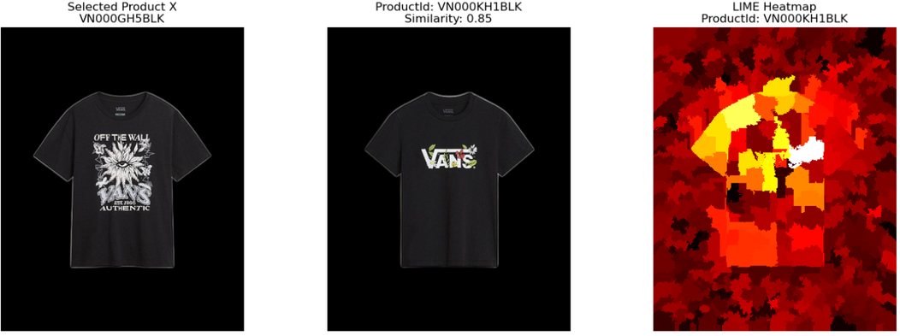
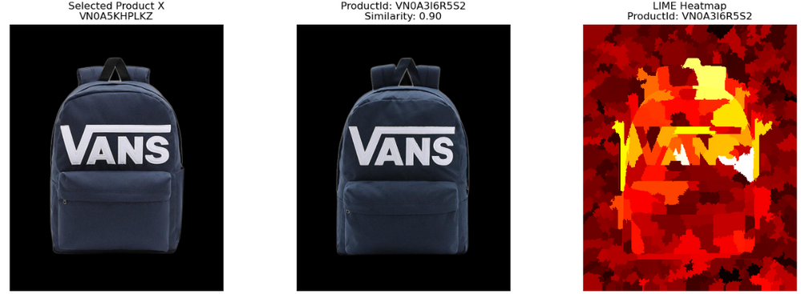
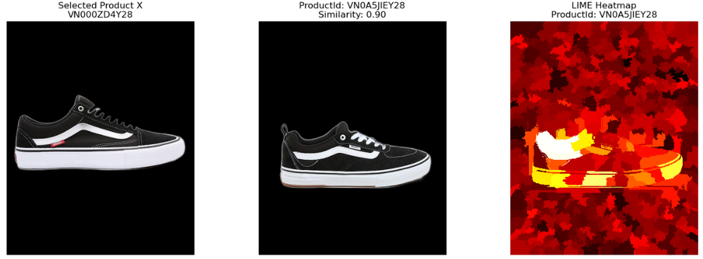
Explainability: LIME
MAASTRICHT UNIVERISITY
Similarity Score
image
86%
Highlights the most influential features
White / Yellow / Orange
Important features
90%
90%
30

Slide 31
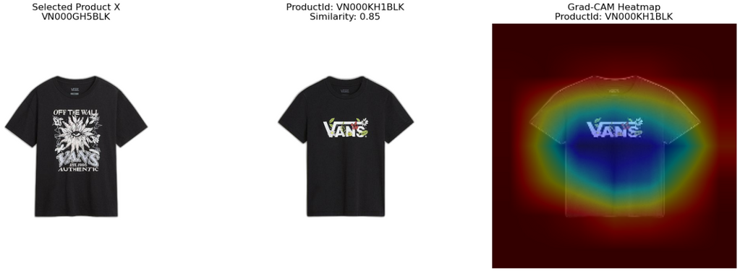
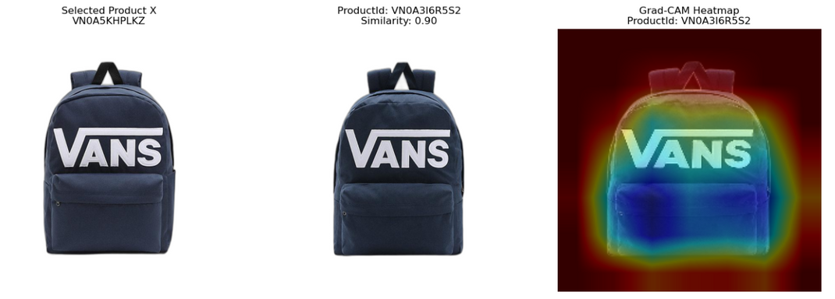

Explainability: GRAD - CAM
MAASTRICHT UNIVERISITY
Similarity Score
image
86%
Visualizes the important regions
Blue area is influential region
90%
90%
31

Slide 32
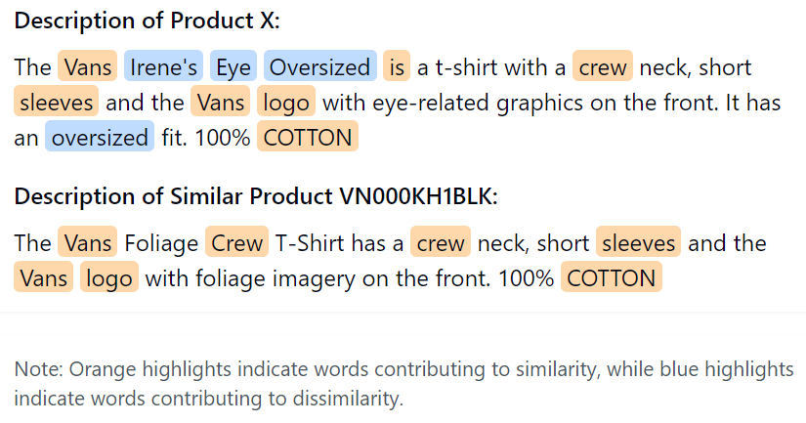
Explainability: LIME
MAASTRICHT UNIVERISITY
text
Orange highlighted words influence positively the similarity score
Blue highlighted words influence negatively the similarity score
32

Slide 33

SURVEY DESIGN
Methodology
66
Questions
4
Randomized Sections
75% - 90%
Similarity Range
33

Slide 34

SURVEY DESIGN
Quantitative Survey
Clarity of Explantion
Helpfulness of Explantion
Confidence in the similarity score
34

Slide 35
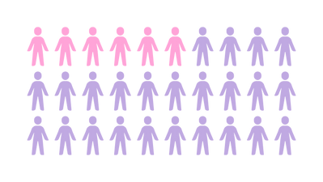
DATA COLLECTION & ANALYSIS
Data Collection
Data Analysis
Online survey of 18 domain experts in Fashion Industry
Comparative Evaluation
Analysis of Multimodal Explanations
35

Slide 36
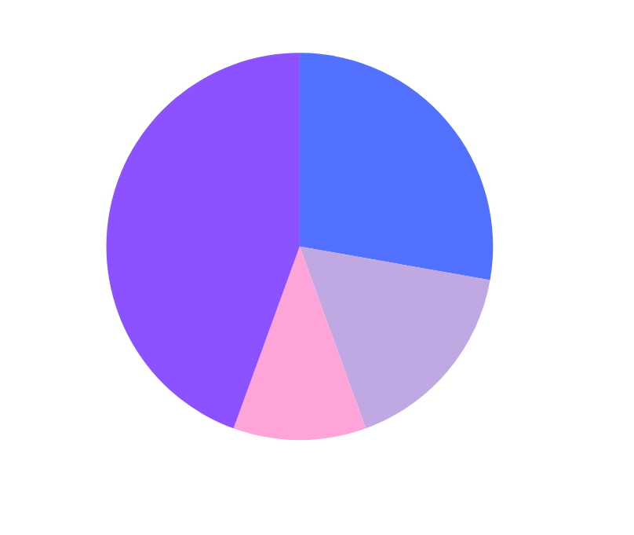
DEMOGRAPHICS
Primary Area of Expertise:
Product Developers
Product Designers
Fashion Merchandisers
Other (E-Comm,Sales,Technology)
36

Slide 37



Prior Exposure to AI Techniques
Years of Experience in their field
66.67%
YES
NO
22.22%
AI Understanding Rate
5.56%
5.56%
37

Slide 38
KEY FINDINGS
73.33%
of participants preferred multimodal explanations
86.67%
of participants reported that combining visual and textual information improved their understanding of product similarity
Possible Violations
Ho
The null hypothesis is rejected for all comparisons (p < 0.05), providing strong evidence for the effectiveness of multimodal explanations
38

Slide 39
MAASTRICHT UNIVERSITY
DISCUSSION
1
How can we effectively integrate multiple data modalities ?
39

Slide 40

MAASTRICHT UNIVERSITY
DISCUSSION
1
How can we effectively integrate multiple data modalities ?
2
How can we explain the similarity scores between items based on multimodal information?
40

Slide 41
MAASTRICHT UNIVERSITY
DISCUSSION
1
How can we effectively integrate multiple data modalities ?
2
How can we explain the similarity scores between items based on multimodal information?
3
How can we evaluate the accuracy and correctness of the explanations provided by explainable AI (XAI) techniques?
41

Slide 42
MAASTRICHT UNIVERSITY
DISCUSSION
1
How can we effectively integrate multiple data modalities ?
2
How can we explain the similarity scores between items based on multimodal information?
3
How can we evaluate the accuracy and correctness of the explanations provided by explainable AI (XAI) techniques?
42

Slide 43





CONCLUSION
Explanations upon Request
A custom model that
handles multiple modalities
43

Slide 44


CONCLUSION & FUTURE WORK
Explanations upon Request
A custom model that
handles multiple modalities
Fine-tune pre-trained
models on Fashion items
Transformation into a supervised task
44

Slide 45



MAASTRICHT UNIVERSITY
AKNOWLEDGEMENTS
Data Science Team
Lead Data Scientist Diego Pennacchioli
Senior Data Scientist Davide Azzalini
Data Scientist Paolo Treccozzi
Data Scientist Gilda Pepe
Data Scientist Roberto Narducci
45

Slide 46

MAASTRICHT UNIVERSITY
THANK YOU
FOR THE ATTENTION
46

Slide 47
APPENDIX
47

Slide 48



MULTIMODAL EXAMPLES
48

Slide 49





EXPLAINABILITY EXAMPLES
49

Slide 50




STATISTICS OVERVIEW
50

